Slide 1
Sampling from categorical distribution: Gumbel-Softmax and other Gumbel-things

Slide 2

Agenda
Introduction to the Gumbel distribution
A trick showoff: Gumbel-Max trick
From max to softmax: Gumbel-Softmax
Examples

Slide 3
Gumbel Distribution
The PDF may look complicated:

Slide 4
Gumbel Distribution
The PDF may look complicated:
But standard Gumbel is much nicer:

Slide 5
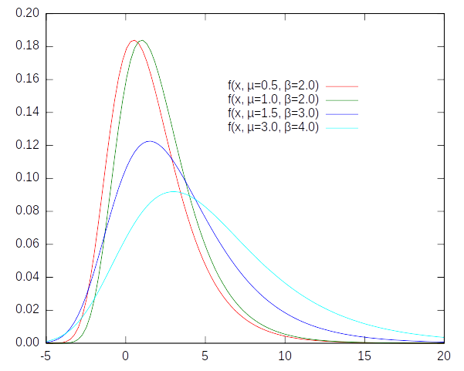
Gumbel Distribution

Slide 6
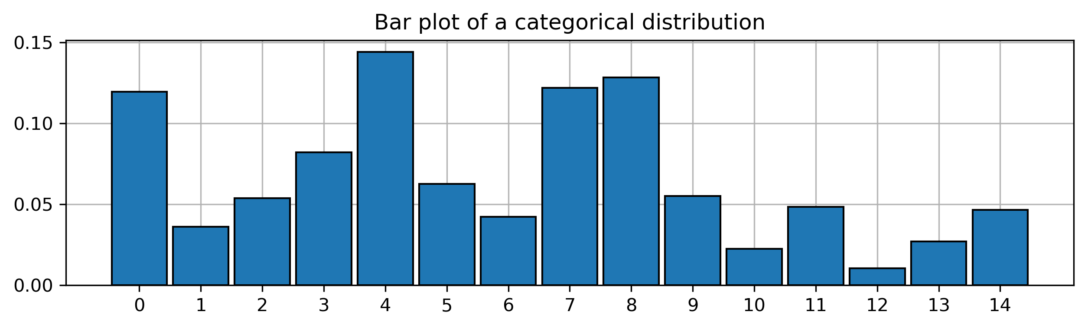
Gumbel-Max Trick
Problem: how to sample from categorical distribution?
Let’s assume that we are able to sample from uniform distribution.

Slide 7
Gumbel-Max Trick
We can do it easily!
np.random.choice(a=range(15), p=probabilities)
Or without numpy:
Split the [0,1] interval into 15 parts with given lengths. Then, as a sample, select a category in which part the U[0,1] sample landed.
So let’s not.

Slide 8
Gumbel-Max Trick
1. Sample from Gumbel Distribution
How? Having only U[0,1] sample, we can do:
Rejection sampling
Ziggurat Algorithm
Slice sampling
Inverse CDF method

Slide 9
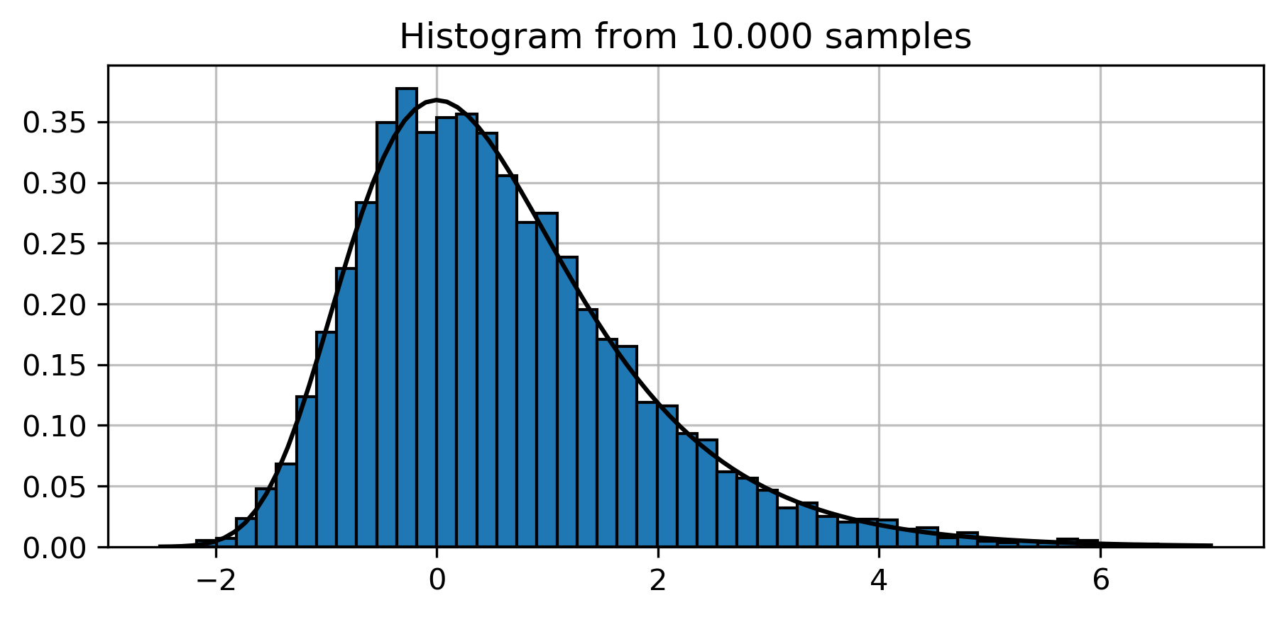
Rejection Sampling
def random_gumbel():
while True:
x = np.random.rand() * 10 - 3
y = np.random.rand()
if y < gumbel_pdf(x):
return x

Slide 10
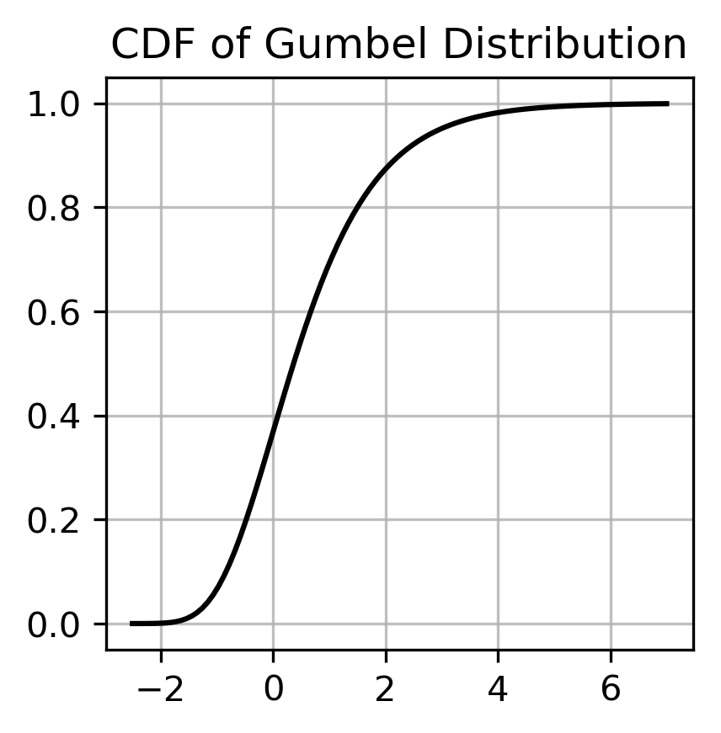
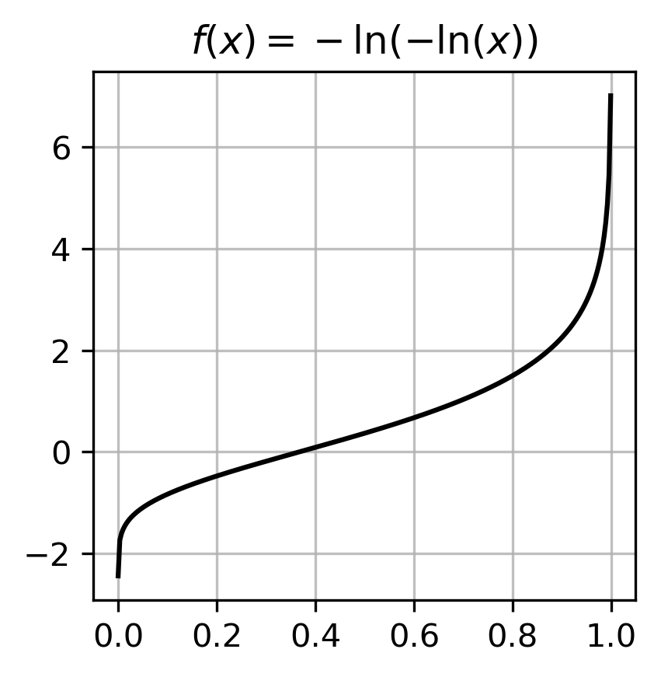
Inverse CDF method

Slide 11
Inverse CDF method

Slide 12
Gumbel-Max Trick
2. Take the logits and add Gumbel noise to it!
Take a logarithm of unnormalized probabilities, then add gumbel noise to it. Argmax from it is a sample from distribution described by these probabilities.

Slide 13
Gumbel-Max Trick
2. Take the logits and add Gumbel noise to it!
Take a logarithm of unnormalized probabilities, then add gumbel noise to it. Argmax from it is a sample from distribution described by these probabilities.
Specifically:

Slide 14
Gumbel-Max Trick
2. Take the logits and add Gumbel noise to it!
Take a logarithm of unnormalized probabilities, then add gumbel noise to it. Argmax from it is a sample from distribution described by these probabilities.
Specifically:
In code:
np.argmax(np.log(logits) + random_gumbel(size=(num_classes)))

Slide 15
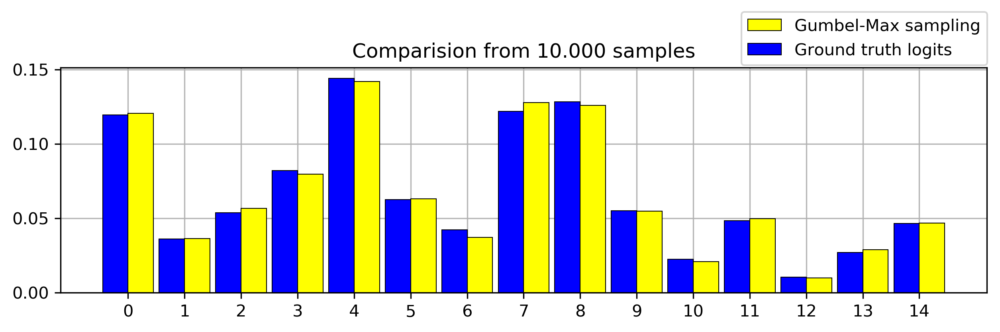
Gumbel-Max Trick
3. Get proper sample:

Slide 16
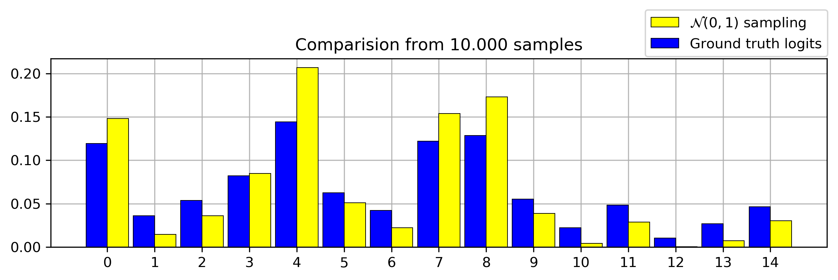
Gumbel-Max Trick
4. Why Gumbel? Let’s add other noise...

Slide 17
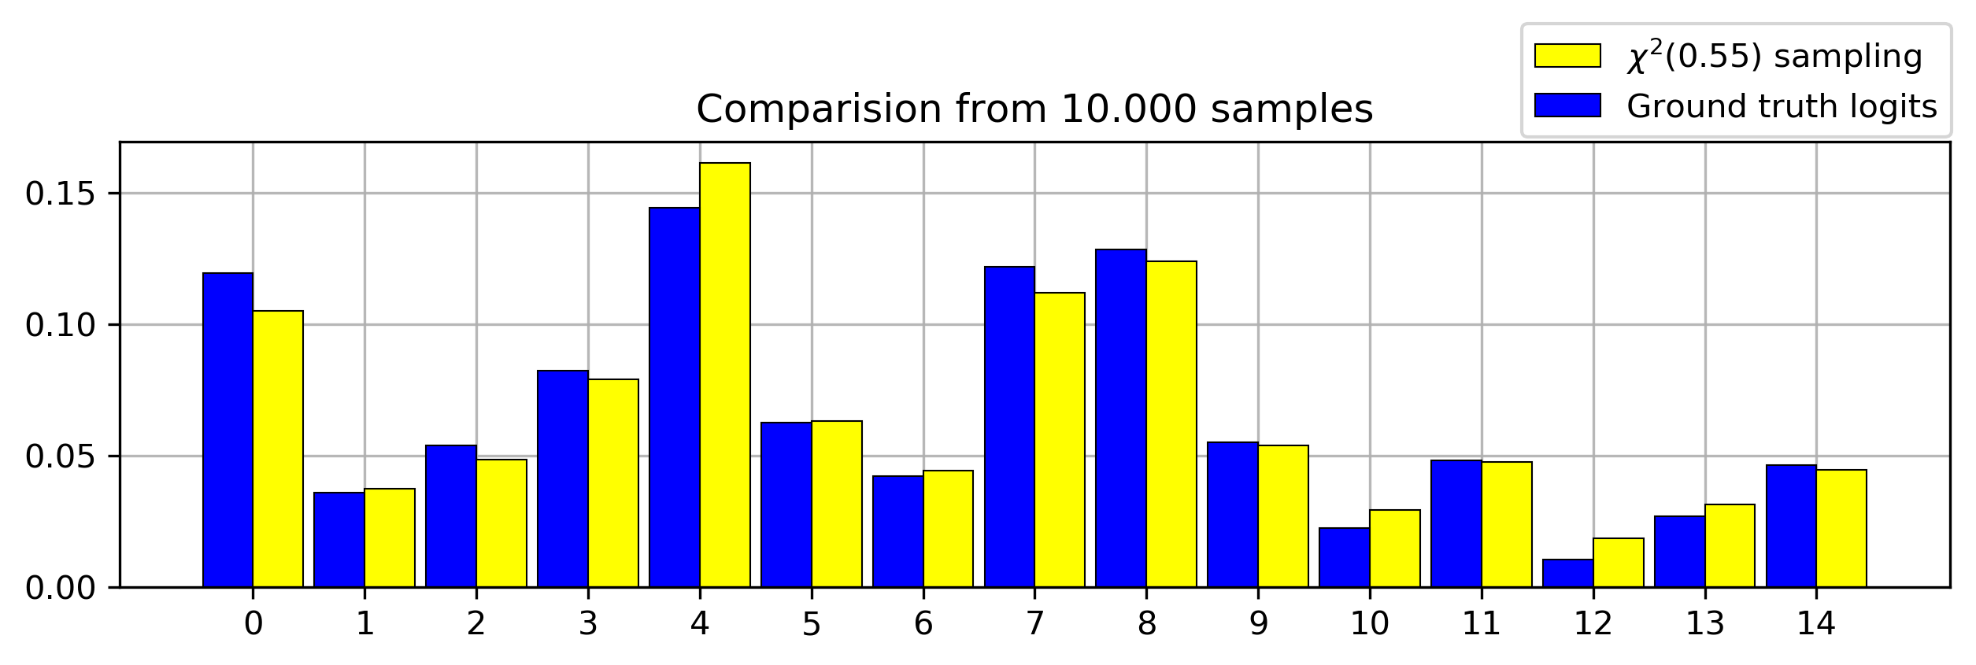

Gumbel-Max Trick
4. Why Gumbel? Let’s add other noise...
Good?

Slide 18
Gumbel-Max Trick
4. Why use Gumbel?
It can be efficient, when you can precompute Gumbel noise.
But it uses argmax... and we can’t differentiate through argmax.
We can’t do „max”, but we can do „softmax”.

Slide 19
Gumbel-Softmax
Good old softmax, but with logits and gumbel noise
There’s the temperature Tau. Let us see, how it affects the results.

Slide 20
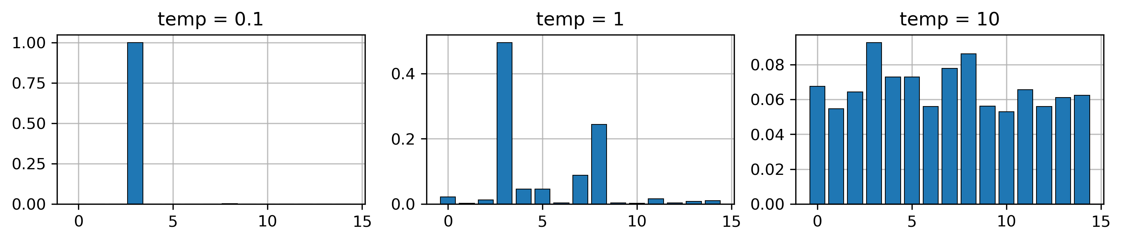
Gumbel-Softmax
How does the temperature affect softmax samples?

Slide 21
VAE
1. Encode the data - map it to a distribution similar to Normal,
2. Sample from the distribution,
3. Decode the data with the decoder.

Slide 22
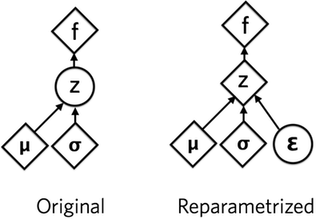
VAE
Step 2: Sampling from the distribution
Reparametrization Trick - why do we do it?
Because we can’t backpropagate through stochastic nodes.

Slide 23
VAE
Step 2: Sampling from the distribution
Gumbel-Softmax is like a Reparametrization Trick for categorical distributions (instead of Gaussian).

Slide 24
VAE
Step 2: Sampling from the distribution
We want to sample from categorical distribution,
We could use Gumbel-Max trick,
But we can’t, because we won’t differentiate through it,
So we use its approximation: Gumbel-Softmax.
There is a temperature parameter in Gumbel-Softmax:
We can gradually anneal it throughout the training. It makes the Gumbel-Softmax a better approximation of categorical distribution, but raises the variance.

Slide 25
VAE: HOWTO
latent_dim = 20
categorical_dim = 10
def forward(self, x, temperature):
encoded = self.encode(x.view(-1, 784))
encoded = encoded.view(-1, latent_dim, categorical_dim)
sample = gumbel_softmax(encoded, temperature)
return self.decode(sample), F.softmax(encoded)

Slide 26
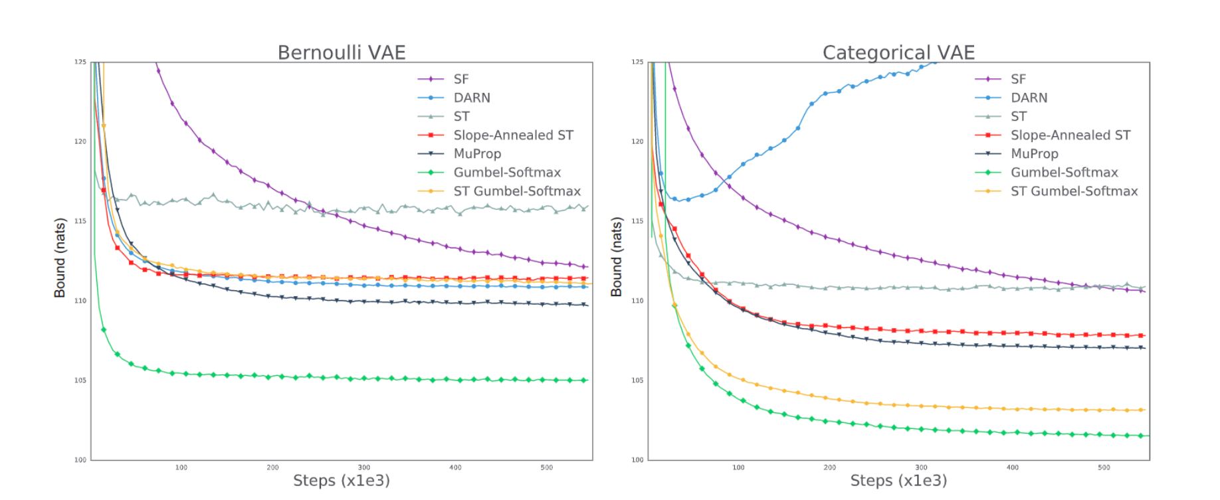
VAE
On Y axis:
variational bounds on validation set

Slide 27
Other examples
Semi-Supervised Generative Models
Structured Output Prediction
Generative Semi-Supervised Classification

Slide 28
Thank You!

